Slide 1

A Dissertation Submitted In Partial Fulfilment For The Degree Of Master Of Technology In Computer Science By Sasanka Jana Roll no. - [CS2227]
Enhancing Confidence Calibration in
Long-Tailed Recognition
Under The Supervision Of Dr. Swagatam Das Electronics And Communication Sciences Unit (ECSU) Indian Statistical Institute, Kolkata June, 2024

Slide 2
Calibration in Classification
Let’s consider an example of a deep learning model used for multi-class classification, such as a model that predicts the type of flower in an image. Suppose we have a dataset of 1000 images of flowers, each labeled with one of three possible classes: rose, daisy, or sunflower.
After training, we evaluate the model’s performance on a separate test set of 100 images. The model outputs a probability score for each class, indicating the likelihood that the image belongs to that class. For example, the model might output a score of 0.8 for the rose class, 0.1 for the daisy class, and 0.1 for the sunflower class for a particular image.
However, these probability scores may not accurately reflect the actual likelihood of each class. For instance, if the model assigns a probability of 80% to an image being a rose, but only 60 out of 100 images labeled as roses actually contain roses, then our model needs to be calibrated..

Slide 3

Accuracy & Calibration
Accuracy refers to the degree of correctness of a measurement or prediction. The accuracy defined as :
$Accuracy= \frac{Correct predictions}{All predictions}$
Calibration on the other hand, is a process used to adjust or standardize a measurement instrument or system to ensure its accuracy. The calibration of a model indicates how close the estimated confidence is to the true probability.
In summary, accuracy measures correctness, while calibration ensures that measurements or predictions are adjusted to match known standards or actual outcomes.

Slide 4
Problem Definition
In the realm of deep neural networks, training on datasets with substantial class imbalances poses a notable challenge. Recently, there has been a trend toward adopting two-stage methodologies, separating the tasks of representation learning and classifier learning to boost performance. Nevertheless, a critical issue that persists is miscalibration.
To address this concern, we've introduced methods specifically crafted to enhance calibration and elevate overall performance in these challenging scenarios.

Slide 5
INTRODUCTION
Deep neural network classifiers have been shown to be mis-calibrated for long-tailed recognition i.e., their prediction probabilities are not reliable confidence estimates. Neural network classifiers are often overconfident in their predictions.
A calibrated neural network classifier outputs class probabilities that match the true correctness likelihood of the class in the ground truth dataset
However, a critical issue remains – miscalibration. To tackle this challenge, we introduce innovative methods designed to improve calibration and performance in such scenarios.
Calibrating neural networks is especially important in safety-critical applications where reliable confidence estimates are crucial for making informed decisions. Some of these applications include medical diagnosis in healthcare and self-driving cars.

Slide 6
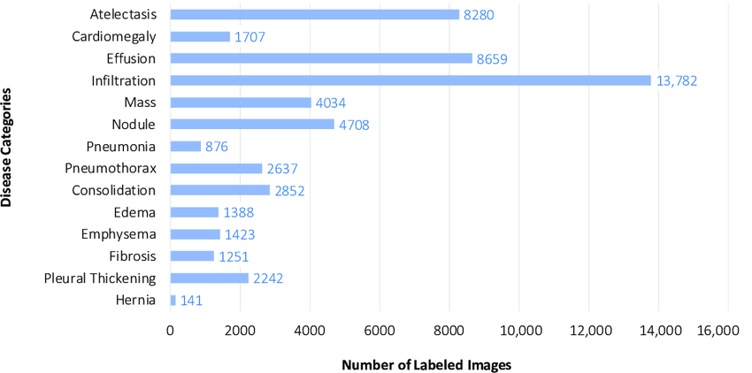
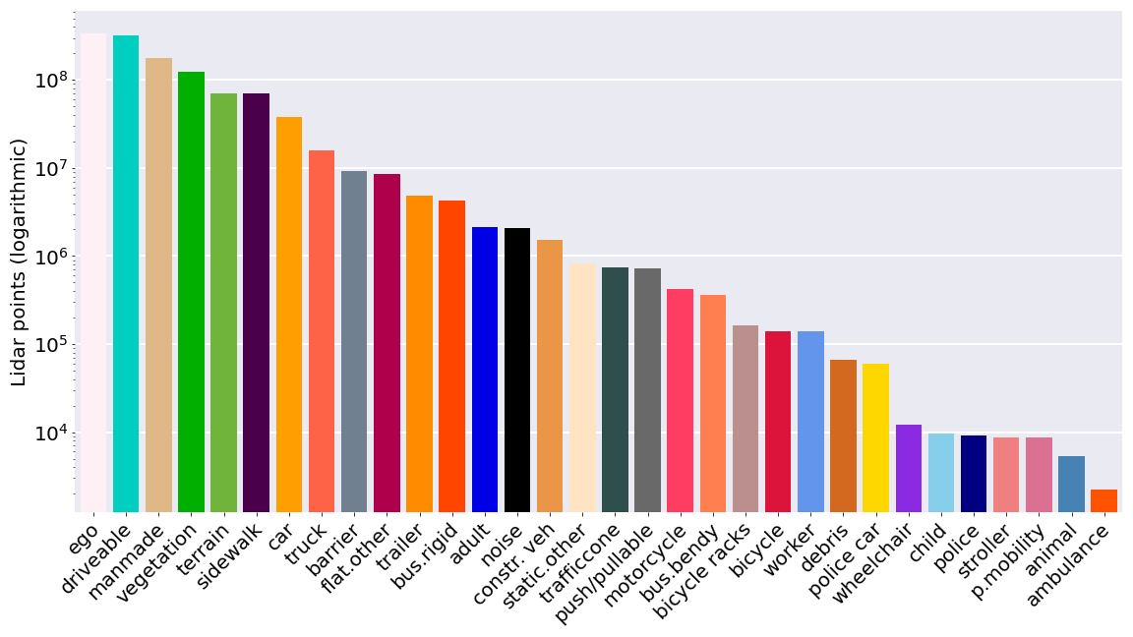
In many real-world scenarios, data often exhibit a class imbalance, where a few instances significantly outweigh the others. This phenomenon is particularly prevalent in various fields, leading to challenges in developing effective machine learning models.
Real life data and Class Imbalance
ChestX-ray dataset comprises 112,120 frontal-view X-ray images of 30,805 unique patients with the text-mined fourteen disease image labels
Autonomous vehicles are driving in many different scenarios, and have to prove that they can drive in all these different circumstances. This is often called the Operational Design Domain (ODD).

Slide 7


Expected Calibration Error (ECE)
We can measure model calibration with the Expected Calibration Error (ECE).
The ECE evaluates the alignment between a model's predicted probabilities and the actual probabilities by computing a weighted mean of the absolute disparity between accuracy (acc) and confidence (conf):
$$ECE=\frac{1}{n}\sum_{m=1}^{M}{\left|B_{m}\right||acc\left(B_{m}\right)−conf(B_{m})|}$$
$conf(B_{m})$represents the average estimated probabilities in bin m , defined as:
$conf\left(B_{m}\right)=\frac{1}{B_{m}}\sum_{i∈B_{m}}{\hat{p_{i}}}$
$acc\left(B_{m}\right)$represents the accuracy per bin m, defined as:
$acc\left(B_{m}\right)=\frac{1}{B_{m}}\sum_{i∈B_{m}}{1(\hat{y_{i}}=y_{i})}$

Slide 8
Review of related work
Re-sampling : Different types of re-sampling methods :
a. Random Under-Sampling
b. Random Over-Sampling
Convolutional Neural Networks (CNNs) struggle with class imbalance, often failing to accurately effect minority classes due to limited samples and biased gradients during training. Techniques like, resampling cost-sensitive learning and data augmentation can help rebalance the training process and improve minority class detection.
Re-weighting : Re-weighting techniques equalize the class distribution by modifying the weights assigned to training instances within the loss function.
Augmentation techniques : Data augmentation methods have evolved to enhance performance of machine learning models by generating new and varied training examples. Here are some notable techniques:
a. CutOut
b. CutMix
c. CutThumbnail

Slide 9
State-of-the-Art Approach : SOTA
Two-stage learning approaches are gaining traction for their effectiveness in handling imbalanced data. In the 1st stage, the model focuses on acquiring knowledge a robust feature representation of the data. The second stage is dedicated to training the classifier, leveraging the learned features to improve classification performance.
The MiSLAS framework improves accuracy and reduces over-confidence in long-tailed datasets using instance-balanced sampling and Mixup. Despite this, models often remain miscalibrated and over-confident in majority classes, indicating a need for better calibration techniques.
Additionally, the LADE method further enhances performance by directly disentangling the source label distribution from model predictions during the training phase, providing state-of-the-art results across various benchmark datasets.

Slide 10
Our Proposed Approaches
Long-tailed datasets cause networks to become miscalibrated and overconfident due to unequal class representation. Both one-stage and two-stage state-of-the-art models suffer from severe over-confidence, especially in majority classes, leading to skewed probability distributions.
Proposed Methods
We focus on addressing over-confidence in two-stage decoupling models using soft label methodologies, augmentation techniques, and Adaptive Weight Adjustment.
Stage 1 : Augmentation Techniques Enhance training data diversity and robustness to improve model generalization across various classes.
Stage 2 : Adaptive Weight Adjustment with Balance Softmax(AWABS) Dynamically adjust class weights based on their representation in training data for a more balanced and calibrated model.

Slide 11
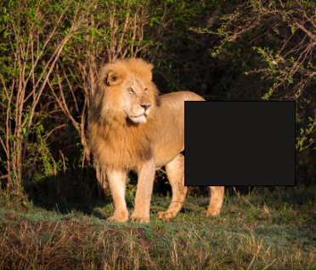
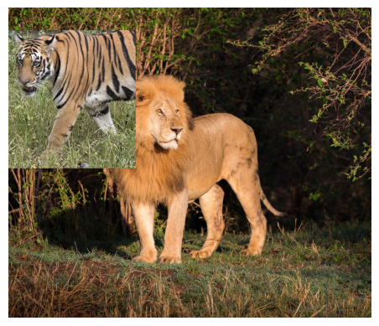

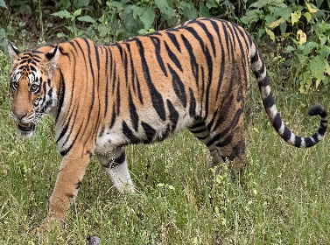
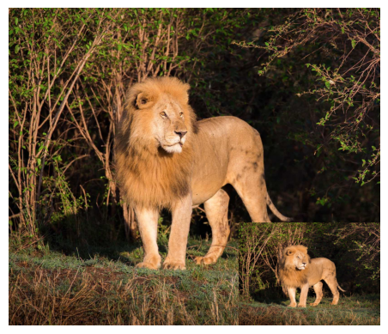
Stage 1: Augmentation Techniques
CutOut:
CutMix:
Original Image
Cut-thumnail:

Slide 12



Stage 2: AWABS
The loss function for K classes is defined as:
$$l\left(y,p\right)=−\log\left(p_{y}\right),$$
$$where p_{y}=softmax(w_{y}^{T}x)= \frac{e^{w_{y}^{T}x}}{\sum_{j=1}^{K}{e^{w_{j}^{T}x}}}$$
The loss function for K classes with label-aware smoothing is defined as :
$$l\left(s,p\right)=−\sum_{i=1}^{K}{s_{i}\log\left(p_{i}\right), where p_{i}=softmax\left(w_{i}^{T}x\right)}and s_{i}=\left\{\begin{aligned}1−ε_{y}=1−f\left(N_{y}\right),i=y \\ \frac{ε_{y}}{K−1}=\frac{f(N_{y})}{K−1}, i≠y\end{aligned}\right.$$
Proposed Approach : Adaptive Weight Adjustment with Balance Softmax (AWABS) Loss defined as :
$$l\left(s,p\right)=−\sum_{i=1}^{K}{s_{i}\log\left(p_{i}\right), }$$
$$where p_{i}=Balance softmax\left(w_{i}^{T}x\right) and s_{i}=\left\{\begin{aligned}1−ε_{y}=1−f\left(N_{y}\right),i=y \\ \frac{ε_{y}}{K−1}=\frac{f(N_{y})}{K−1}, i≠y\end{aligned}\right.$$

Slide 13


Stage 2: AWABS
Balance softmax loss is defined as :
$l\left(y,p\right)=−log\left(p_{y}\right) , where p_{y}=Balancesoftmax\left(w_{y}^{T}x\right)=\frac{n_{y}e^{w_{y}^{T}x}}{\sum_{j=1}^{K}{n_{j}e^{w_{j}^{T}x}}} , n_{y}$ represents how many samples there are from class y.
The proposed loss function becomes :
$$l\left(s,p\right)=−\sum_{i=1}^{K}{s_{i}\log\left(p_{i}\right)},where p_{i}=Balancesoftmax\left(w_{i}^{T}x\right)=\frac{n_{i}e^{w_{i}^{T}x}}{\sum_{j=1}^{K}{n_{j}e^{w_{j}^{T}x}}}$$
$$and{ s}_{i}=\left\{\begin{aligned}1−ε_{y}=1−f\left(N_{y}\right),i=y \\ \frac{ε_{y}}{K−1}=\frac{f(N_{y})}{K−1}, i≠y\end{aligned}, s.t \sum_{i=1}^{K}{p_{i}=1}\right..$$

Slide 14



Stage 2: AWABS
Now according to our proposed method the optimal solution of $w_{i}^{T}x$ is given by
${w^{∗}}_{i}^{T}x=\left\{\begin{aligned}\frac{log⁡(K(1−ε_{y}))}{n_{y}ε_{y}}+c, if i=y \\ c, if i≠y\end{aligned}\right.$
In the long-tailed dataset, we arrange the labels in descending rank based on the quantity of instances, represented as $N_{1}≥N_{2}≥N_{3}≥….≥N_{K}.$
We propose increasing label smoothing for classes with more instances to balance model confidence, ensuring head classes, which have more varied examples, do not overshadow tail classes with fewer examples.
To achieve this, we introduce different types of related functions $f(N_{y})$ :
Concave form :
$$f\left(N_{y}\right)=ε_{K}+(ε_{1}−ε_{K})\sin\left(\frac{π(N_{y}−N_{K})}{2(N_{1}−N_{k})}\right)$$
Linear for :
$$f\left(N_{y}\right)=ε_{K}+(ε_{1}−ε_{K})\left(\frac{(N_{y}−N_{K})}{(N_{1}−N_{K})}\right)$$
Here, $ε_{1}$ and $ε_{K}$ are two hyperparameters and $ε_{1}>ε_{K}$.

Slide 15
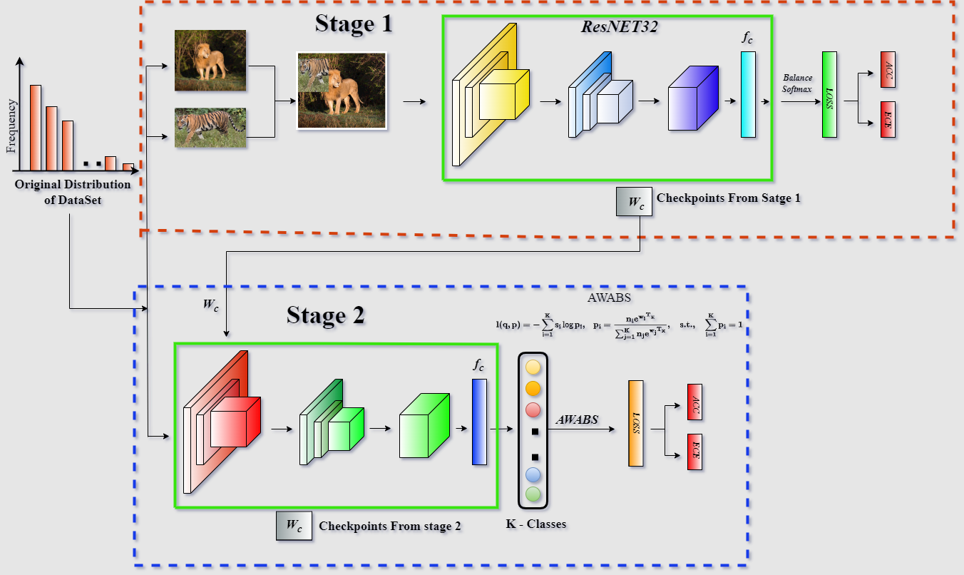
Proposed Framework

Slide 16
Proposed methods
Stage 1
Stage 2
Method 1 :
Method 2 :
Method 3 :
AWABS
CutOut
CutMix
Cut-Thumbnal

Slide 17
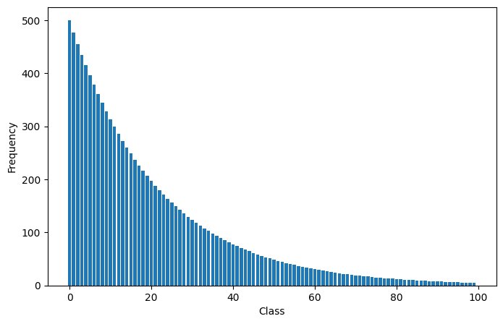

Explanation of Datasets
The CIFAR10 and CIFAR100 datasets, which comprise 60k images each—50k for training and 10k for validation are popular benchmarks. we make use of the long tailed on these CIFAR datasets to guarantee a fair comparison.
Imbalance factor (IF) $β=\frac{N_{max}}{N_{min}},$where $N_{min}$ and $N_{max}$ stand for the amount of training samples for the least frequent classes and most respectively.
We perform experiments employing IF of 200, 100, 50, and 10.
 | CIFAR10 | CIFAR100
 | Class Index
Head | 0-3 | 0-30
Middle | 3-7 | 40-70
Tail | 7-10 | 70-100
To further analyze the effects of imbalance, we categorize the classes into Head, Middle, and Tail classes based on their frequency.

Slide 18
Comparison with SOTA
ResNet 32 based models, trained on CIFAR10-LT, top-1 accuracy (%) /ECE
Method | CIFAR10
IF | 100 | 50 | 10
CE | 70.4 | 74.8 | 86.4
mixup | 73.1 | 77.8 | 87.1
BBN | 79.9 | 82.2 | 88.4
LDAM+DRW | 77.1 | 81.1 | 88.4
DRW+REMIX | 79.8 | - | 89.1
cRT+mixup | 79.1 / 10.6 | 84.2 / 6.89 | -
LWS+mixup | 76.3 / 15.6 | 82.6 / 11.0 | 89.6 / 5.41
MiSLAS | 82.1 / 3.70 | 85.7 / 2.17 | 90.0 / 1.20
Proposed Method 1 | 81.950 / 3.696 | 84.770 / 2.162 | 90.010 / 1.534
Proposed Method 2 | 82.2 / 2.55 | 85.57 / 2.56 | 90.59 / 1.63
Proposed Method 3 | 82.460 / 3.527 | 85.840 / 2.717 | 90.500 / 2.371

Slide 19
Comparison with SOTA
ResNet 32 based models, trained on CIFAR100-LT, top-1 accuracy (%) /ECE
Method | CIFAR100
IF | 200 | 100 | 50 | 10
CE | 36.5 | 38.4 | 43.9 | 55.8
mixup | - | 39.6 | 45 | 58.2
LDAM+DRW | 38.5 | 42.1 | 46.7 | 58.8
BBN | - | 42.6 | 47.1 | 59.2
LADE | - | 45.4 / 2.54 | 50.5 / 0.148 | 61.7 / 1.46
DRW+REMIX | 38.45 | 46.8 | 46.62 | 61.3
cRT+mixup | 40.16 | 45.1 / 13.8 | 50.9 / 10.8 | 62.1 / 6.83
LWS+mixup | 44.9 | 44.2 / 22.5 | 50.7 / 19.2 | 62.3 / 13.4
MiSLAS | 43.53 | 47.0 / 4.83 | 52.3 / 2.25 | 63.2 / 1.73
Proposed Method 1 | 45.910 / 2.668 | 48.130 / 6.376 | 52.430 / 2.120 | 62.400 / 1.223
Proposed Method 2 | 45.930 / 1.286 | 48.03 / 1.96 | 51.44 / 1.32 | 62.35 / 1.26
Proposed Method 3 | 44.470 / 2.460 | 46.690 / 4.631 | 50.500 / 2.895 | 61.320 / 2.113
19

Slide 20
Different splits of classes
Performance comparison of different methods on CIFAR100LT with IF 100, evaluating accuracy across three class splits: Head, Middle, and Tail
Method | Head | Middle | Tail | Top 1% ACC
MiSLAS | 63.3 | 46.7 | 22.7 | 47
LWS | 61.4 | 43.4 | 19.6 | 44.2
cRT | 65.91 | 43.74 | 23.8 | 45.1
Proposed Method 1 | 64.056 | 49.686 | 26.483 | 48.13
Proposed Method 2 | 61.556 | 48.429 | 27.724 | 48.03
Proposed Method 3 | 59.528 | 47 | 27.448 | 46.69

Slide 21
Summary of Proposed Methods
Our proposed methods demonstrated superior performance:
Proposed Method 2 again demonstrates superior performance, showing the highest accuracy for IF 200 and IF 100, while maintaining low ECE across all imbalance factors.
Proposed Method 1 also performs well, particularly for IF 50, with notable accuracy and low ECE.
Proposed Method 1 demonstrates the best overall performance in terms of Top 1% ACC (48.13%), with the highest accuracy in the middle class split and strong performance in the head and tail splits.
Proposed Method 2 shows the highest accuracy in the tail class split (27.724%) and competitive performance across all class splits, resulting in a high Top 1% ACC of 48.03%.
The proposed methods, particularly Proposed Method 2, show significant improvements over existing methods in terms of both accuracy and calibration (ECE) for imbalanced CIFAR10-LT and CIFAR100-LT datasets.

Slide 22
Conclusion
To conclude the comparison between various resnet-32 based models trained on CIFAR10-LT and CIFAR100-LT datasets, we observe significant variations in performance metrics, particularly in terms of top-1 accuracy and ECE. Let’s highlight some key findings:
Consistency : The proposed method 2 consistently outperforms or matches other methods in terms of accuracy and calibration on both CIFAR10-LT and CIFAR100-LT datasets.
Robustness : Proposed method 2 shows robustness across different levels of class imbalance, indicating its applicability in various real-world scenarios.
Calibration : The proposed methods exhibit superior calibration, crucial for reliable uncertainty estimation in classification tasks. Competitive performance : While mislas and LADE demonstrate competitive performance, the proposed method 2 consistently achieves the best balance between accuracy and calibration.
In summary, the results suggest that the proposed method 2 presents a promising approach for addressing class imbalances in classification tasks, offering superior performance in terms of accuracy and calibration across both CIFAR10-LT and CIFAR100-LT datasets.

Slide 23
Future Work
Looking ahead, there are several exciting avenues for future research that can further enhance the capabilities of our proposed methods
1. Exploration of Mixed Cut Thumbnails
2. Dynamic Balance Softmax Loss Functions
3. Implementation of a Reverse Sampler
Adapting to Other Long-Tailed Datasets: Extending our proposed methods to other long-tailed datasets beyond CIFAR100-LT can validate their generalizability and effectiveness in diverse real-world scenarios. Understanding how these techniques perform across different domains and data distributions is crucial for advancing the field of class imbalance mitigation.

Slide 24
Thank You

